Slide 1

Less stress when sharing expenses with anyone.

Slide 2
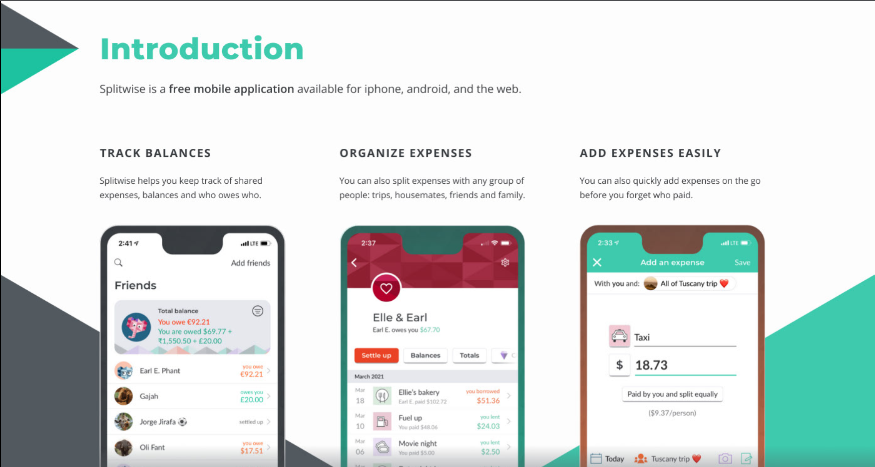
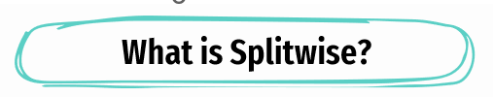

Slide 3
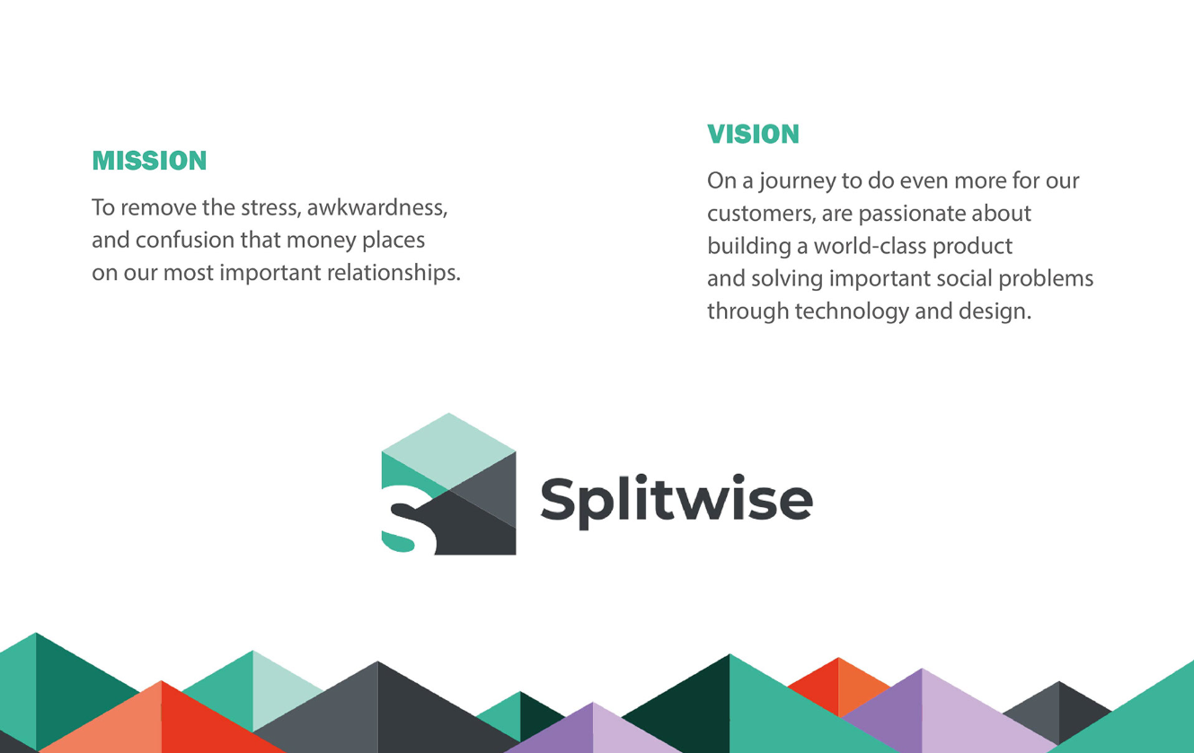


Slide 4
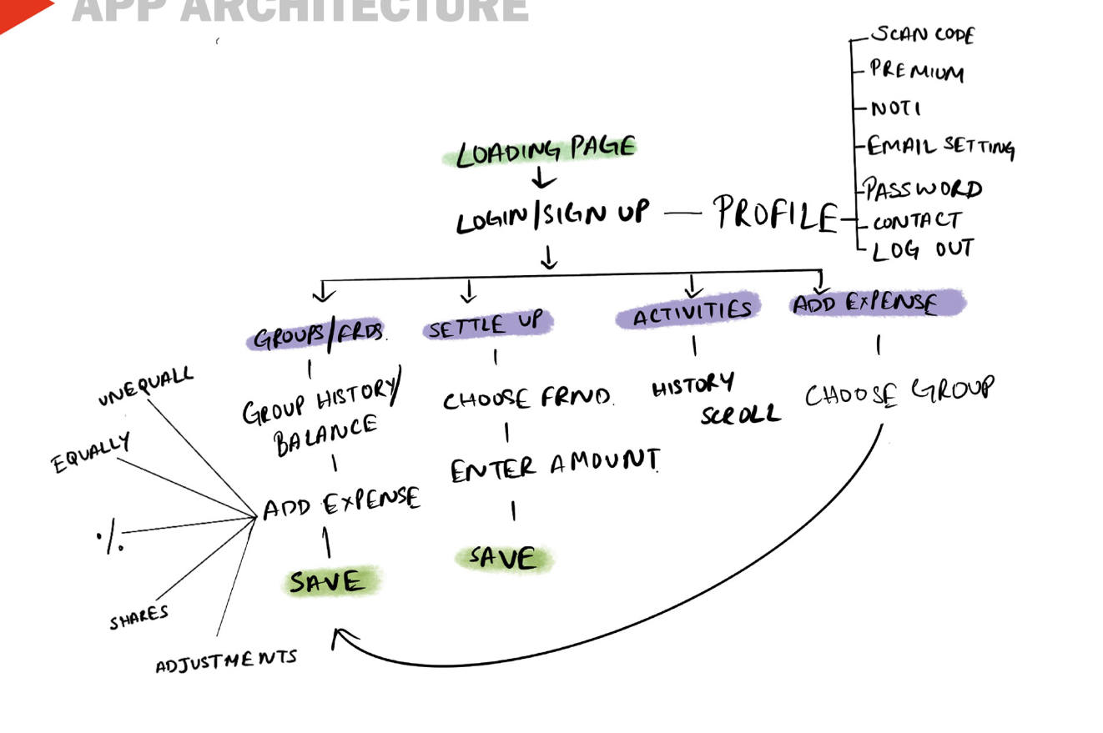
APP ARCHITECHTURE

Slide 5
Objectives
Create a Plan of Action
4
Address the pain points and propose probable solutions.
3
2
User surveys specifically around adding and organising bills.
1
To conduct user surveys and find out how people use Splitwise.

Slide 6

Understanding End User

Slide 7
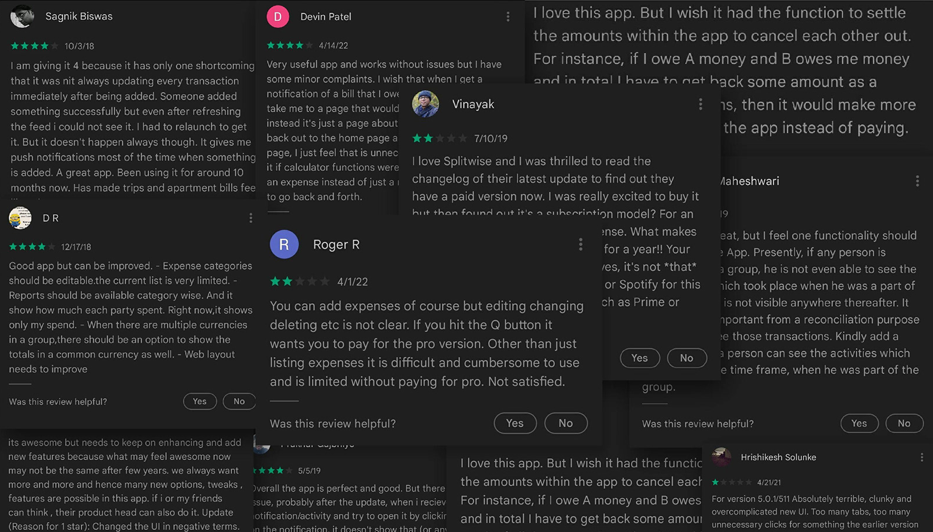

Slide 8
Design Roadmap
1
2
3
4
EMPATHISE
Define
IDEATE
Prototype
User testing Persona Analysis
Pain Points Customer Journey Emphasize needs
Rough sketches Mid fidelity sceens
High Fidelity screens

Slide 9
Pain Points / Required Features
UI/UX issues
New Feature
Group Details
Payment Gateway
Organizing & Searching bills
Sending Reminders

Slide 10
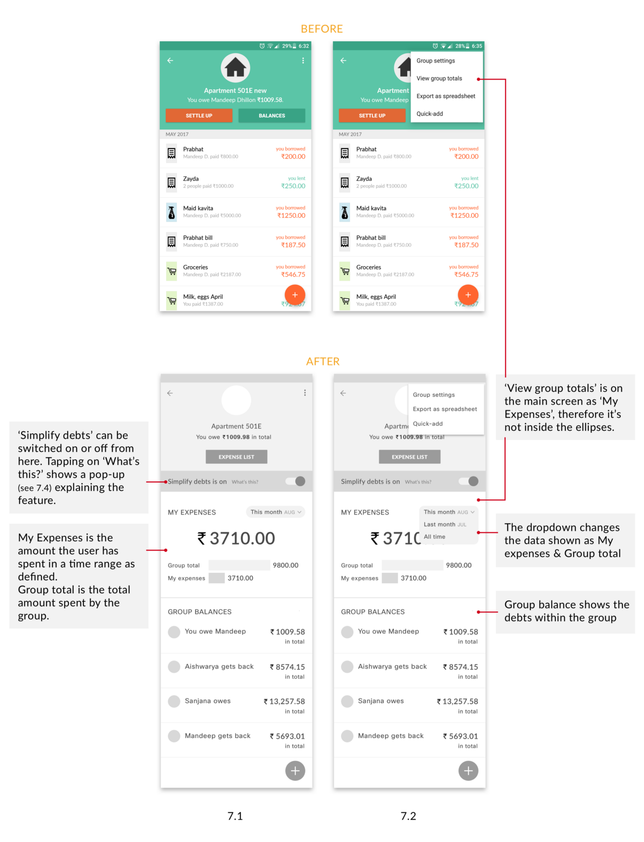
Group Details
UI Redesigned
‘View group totals’ and ‘Balances’ are not hidden anymore. They are on the main screen as ‘My expenses’ and ‘Group balances’ respectively.
Simplify debts is upfront.
The action to ‘Settle up’ is no longer a separate button. It is shown only when the user owes somebody (under Group balance).
The buttons, ‘Settle up’ and ‘ Balances’, have been replaced by ‘Expense list’ which leads the user to a list of the expenses in that group.

Slide 11
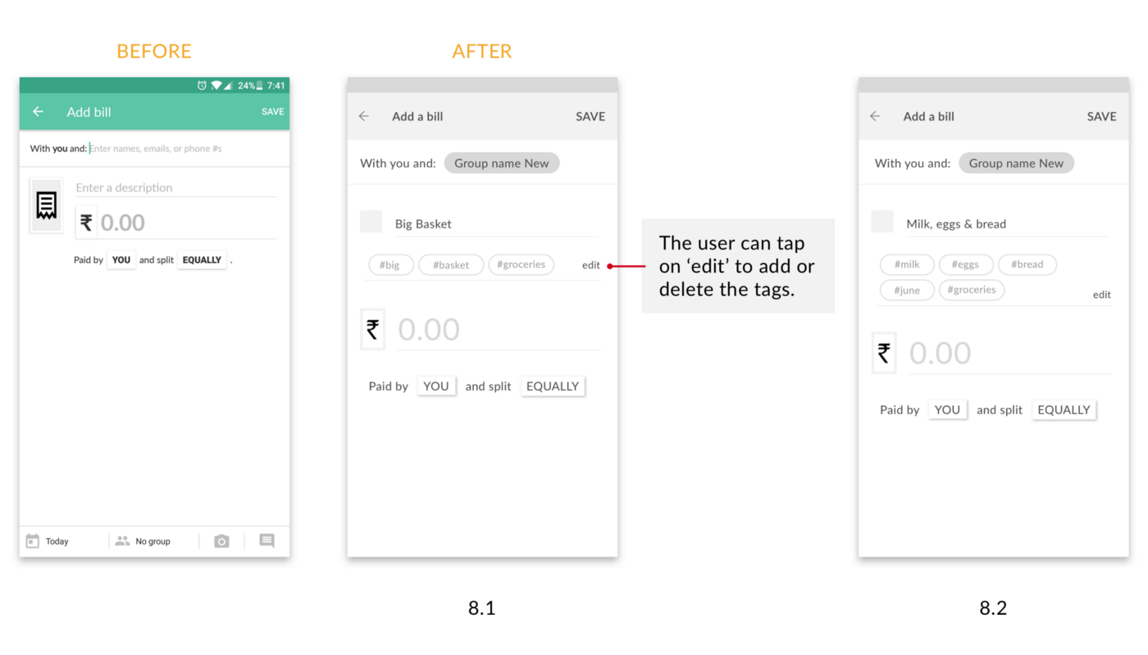
Organizing & Searching bills
UI Redesigned
Adding a Bill
Earlier it was not possible to categorize bills.
Now your bill description will be converted to tags which you choose from.

Slide 12
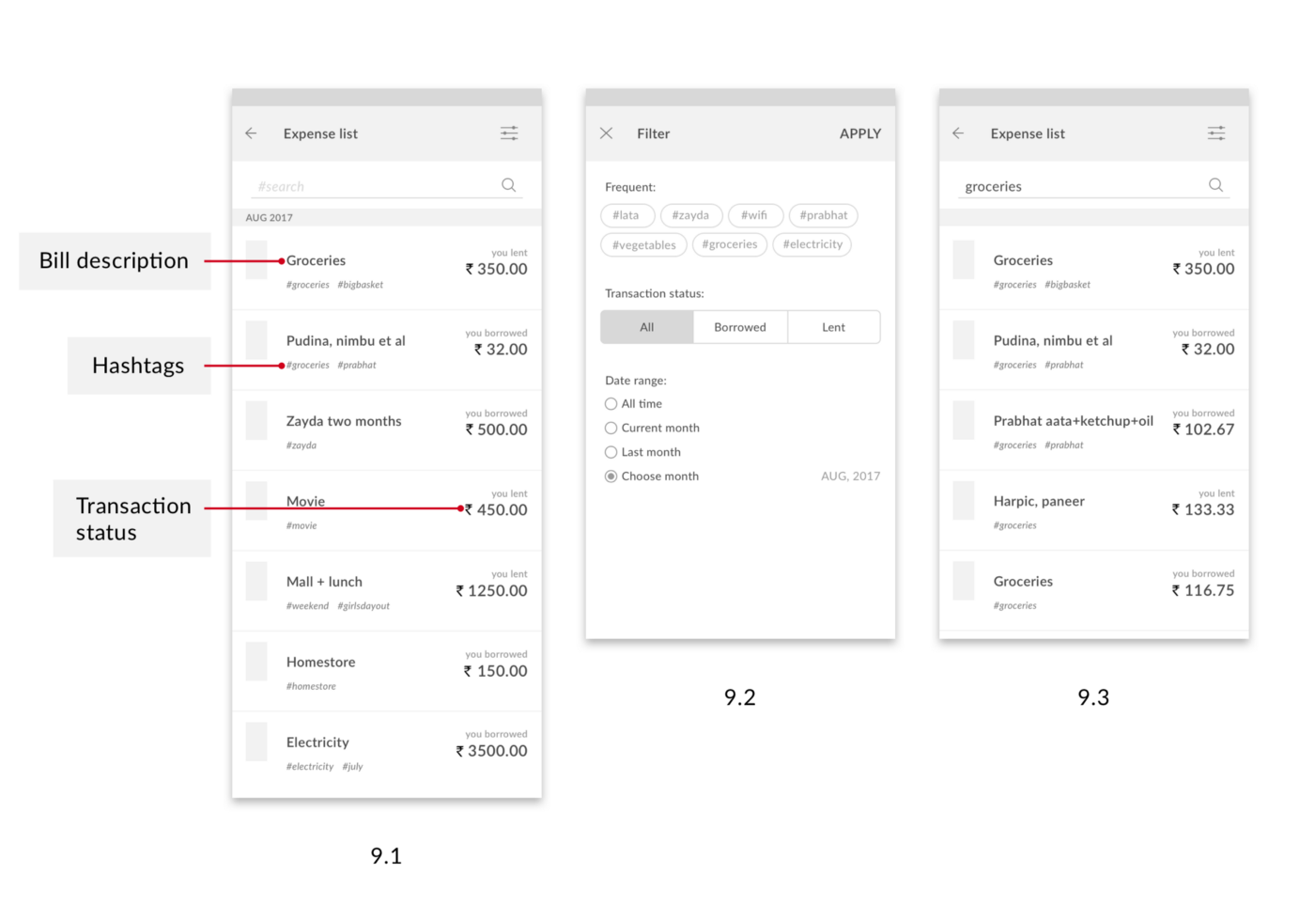
Organizing & Searching bills
UI Redesigned
Searching for a bill
Tapping on the ‘Expense list’ button on the Group detail screen will lead the user to the list.
The user can search for specific bills by typing some words of the description in the search bar.
The ‘Filters’, on the top right corner, help narrow down the search.
All expenses with the tags, typed in the search field, populate the screen.

Slide 13
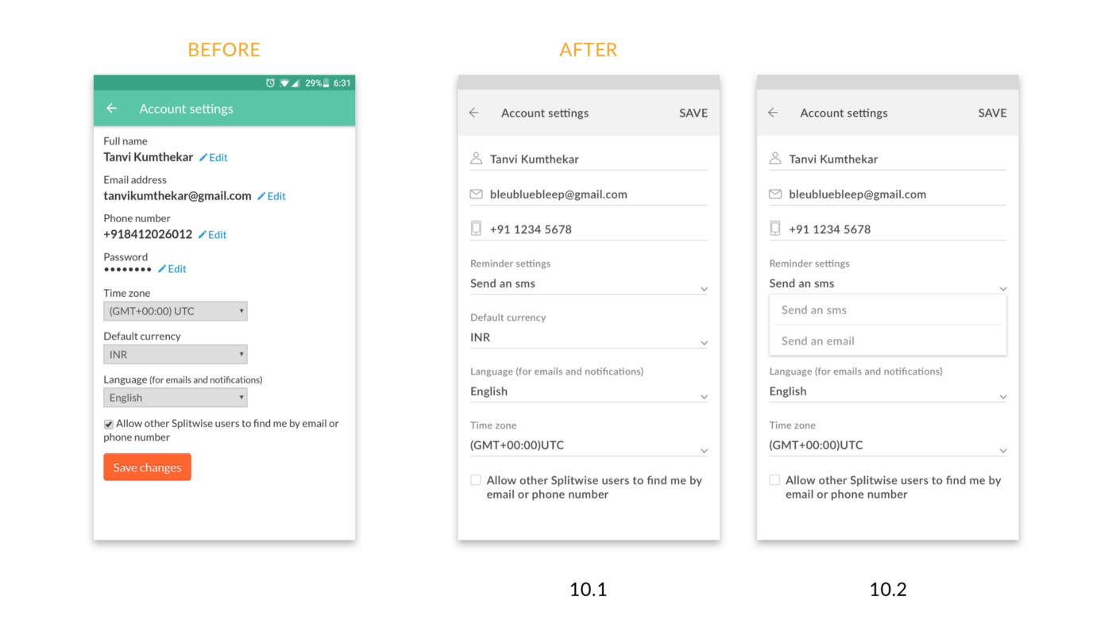
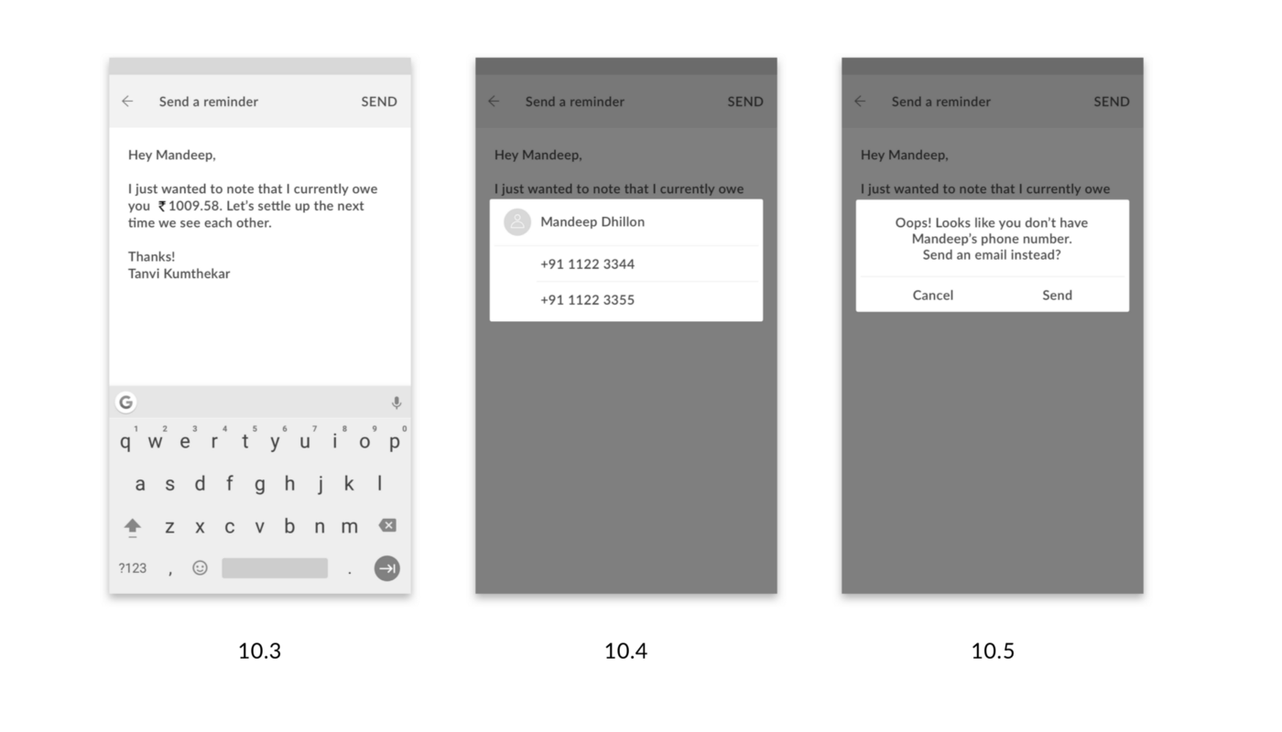
Sending Reminders
UI Redesigned
The user makes a default setting in the Account settings, choosing whether the reminder should be sent as an email or an SMS. The reminder message is a template provided by the app.

Slide 14
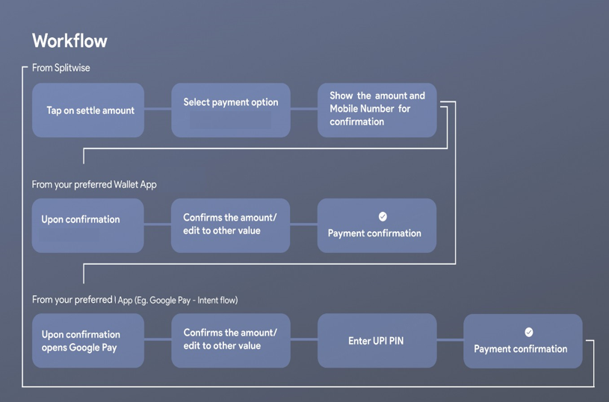
Payments Gateway
New Feature
Step 1: Select settle balance
Step 2: Select the preferred payment method
Step 3: Confirms the mobile no
Step 4: Make the payment
Step 4: Relax

Slide 15

Splitwise 2.0
New Tag

